Slide 1

Phishing Awareness Training
This training will help you recognize and avoid phishing attacks, a common cybersecurity threat.

Slide 2
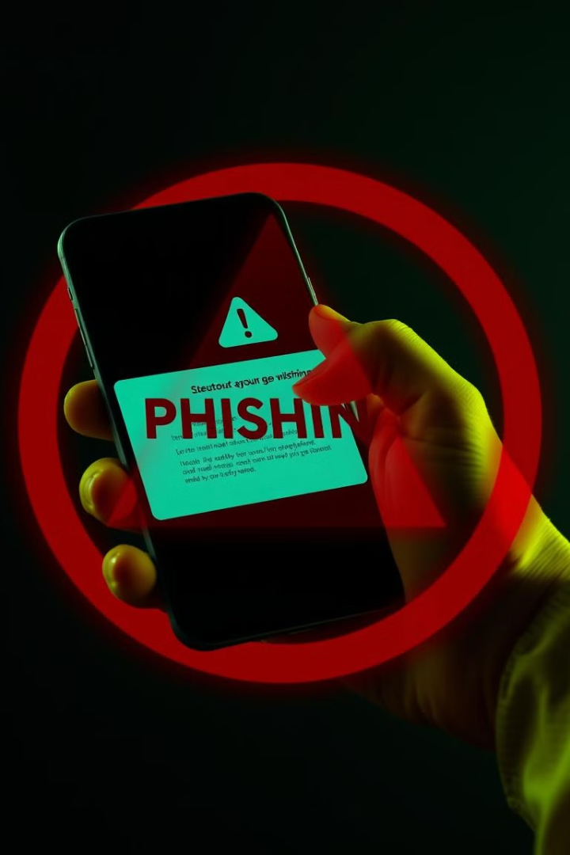
Introduction to Phishing
Phishing is a cyberattack where attackers impersonate legitimate entities to trick people into sharing sensitive information.
1
Steal Personal Information
2
Spread Malware
Phishing can be used to distribute malware or ransomware, which can harm your device and data.
Attackers aim to steal passwords, credit card numbers, and other sensitive data.
3
Unauthorized Transactions
Attackers can use stolen information to make unauthorized financial transactions.

Slide 3
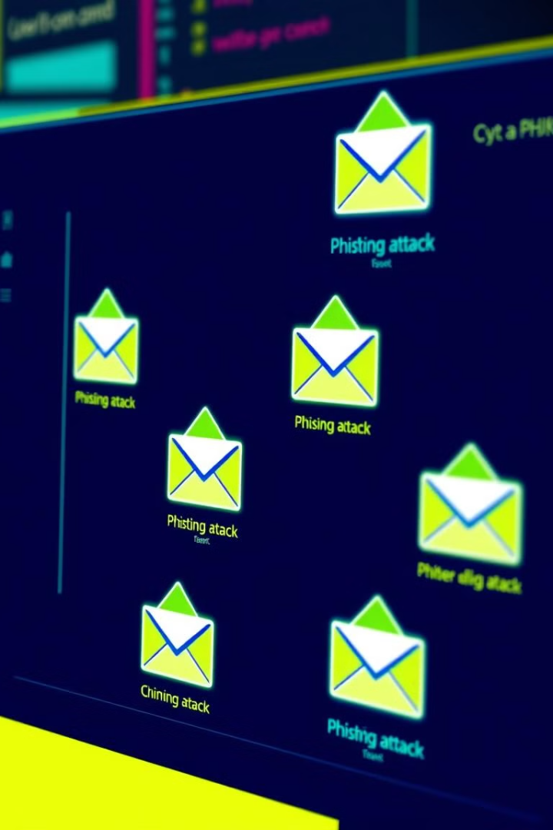




Types of Phishing Attacks
Phishing attacks come in various forms, each with its own characteristics and targets.
Email Phishing
Spear Phishing
Attackers send mass emails that appear legitimate, tricking recipients into clicking malicious links.
More targeted attacks customized for specific individuals or organizations, making them harder to detect.
Whaling
Smishing and Vishing
Attackers target high-profile individuals, like executives, for more significant potential rewards.
Smishing uses SMS to send fraudulent messages, while vishing uses voice calls to deceive victims.

Slide 4
Anatomy of a Phishing Email
Phishing emails often contain specific elements that can help you identify them as fraudulent.
Suspicious Sender Address
Urgent Language
Malicious Links and Attachments
Phishers create a sense of urgency, often using phrases like "Act now to secure your account!"
The sender address may mimic a legitimate email but have subtle changes.
Links often lead to fake websites, and attachments might carry malware.

Slide 5
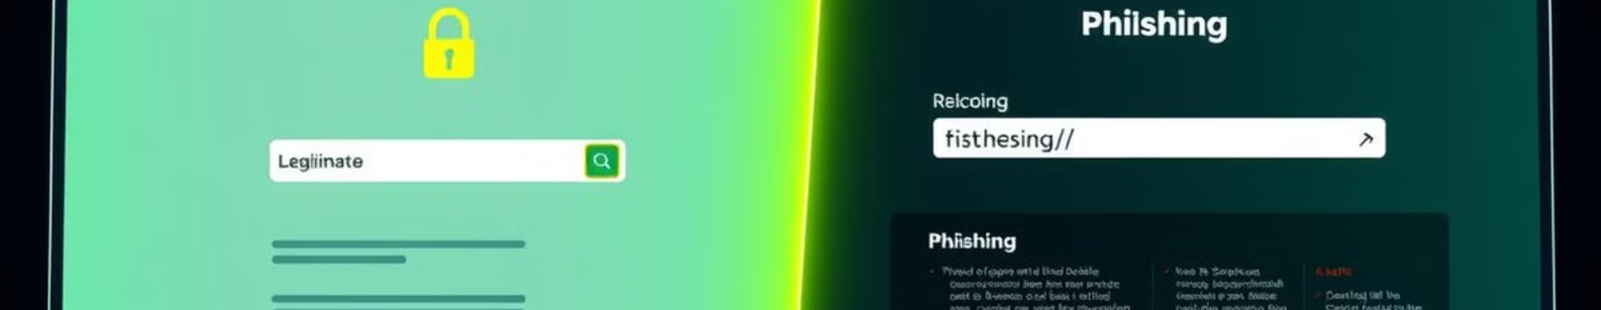
Phishing Websites
Phishing websites are designed to mimic real websites to capture sensitive data.
1
URL Differences
2
Security Indicators
3
Design and Content Quality
Phishing websites often have slight changes in URLs or spelling errors.
They may lack HTTPS (secure protocol) or have missing security indicators.
Phishing websites may have poor spelling, formatting, or overall design quality.

Slide 6
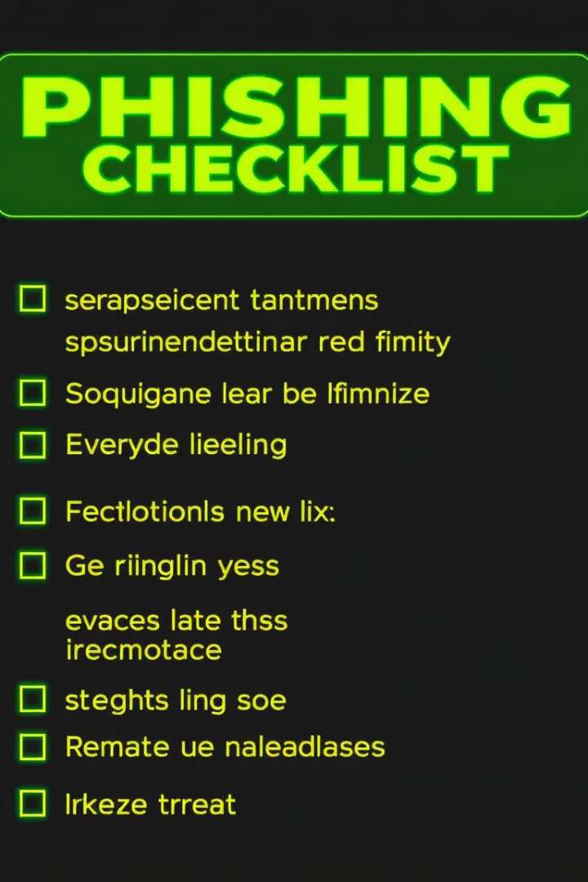
Recognizing Phishing Attempts
Phishers use various techniques to trick users into giving up sensitive information.
Emotional Appeals
Too-Good-to-Be-True Offers
Phishers create fear or urgency to manipulate users into taking action.
They may promise free prizes or money to entice users to click or provide information.
Appeals to Trust or Authority
Phishers may impersonate well-known companies or institutions to gain trust.

Slide 7




Social Engineering Tactics in Phishing
Social engineering is a psychological manipulation technique used to gain user trust and access.
Pretexting
Phishers create a story to manipulate the victim into providing information.
Baiting
They offer something enticing to get users to lower their guard and click on malicious links.
Tailgating and Impersonation
Phishers physically or virtually pose as someone trusted to gain access to systems or information.

Slide 8
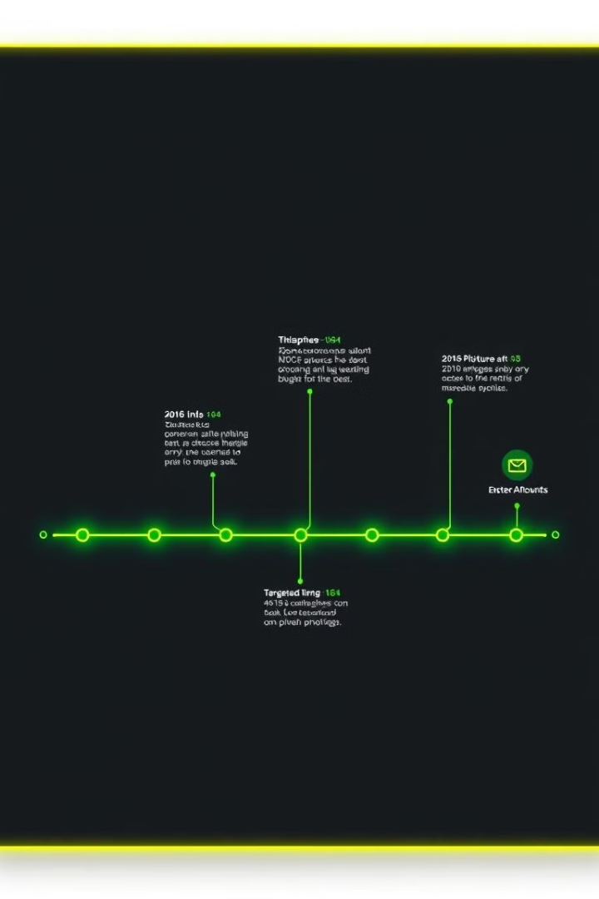
Common Scenarios and Case Studies
Real-world examples highlight the effectiveness of phishing attacks and the importance of vigilance.
2016 DNC Email Phishing Incident
Spear-phishing emails led to significant data exposure.
Targeted Whaling Attack on a CEO
Illustrates the financial and reputational damage caused by phishing attacks.

Slide 9
How Phishing Can Impact You and Your Organization
Phishing attacks can have significant consequences for individuals and organizations.
Personal Impact
Organizational Impact
Identity theft, financial losses, and damaged reputation.
Data breaches, financial losses, legal ramifications, and reputational damage.

Slide 10
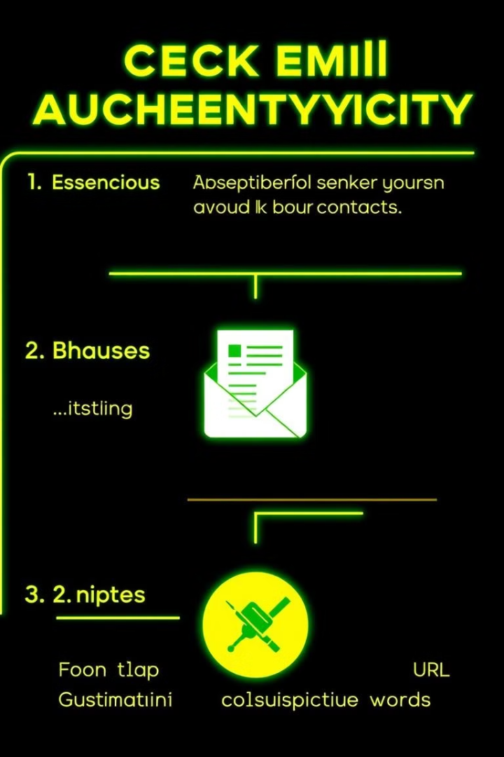
Avoiding Phishing Emails and Messages
Taking precautions can help you avoid falling victim to phishing attacks.
1
Verify the Sender
Check email addresses closely for any inconsistencies or suspicious patterns.
2
Hover Over Links
Inspect links before clicking to ensure they lead to legitimate websites.
3
Inspect for Grammar/Spelling Errors
Phishing emails often contain grammatical or spelling errors, which can be a red flag.

Slide 11

Best Practices for Staying Safe Online
Password Security:
Encourage using complex, unique passwords. Recommend password
managers to help manage passwords securely.
Enable Two-Factor Authentication (2FA):
Adds an extra security layer, requiring both a password and a temporary code.
Visual:
Image or icon representation of a strong password and 2FA process.

Slide 12

Reporting Phishing Attempts
Report suspicious emails, texts, or phone calls to protect yourself and others.
Organizations have dedicated reporting channels to handle phishing incidents.
Reporting helps identify threats, improve security measures, and prevent future attacks.

Slide 13

Interactive Quiz or Scenarios
Interactive Component: Quiz or role-playing scenarios to test knowledge.
Examples where users identify phishing attempts based on characteristics discussed.
Scenarios: Realistic examples (email screenshots or fake website screenshots).
Objective: Reinforce the training material through engagement.

Slide 14

Conclusion and Key Takeaways
Recap: Summarize the main points, stressing the importance of vigilance and proactive reporting.
Encourage Ongoing Vigilance: Remind users that phishing attempts are constant and evolving.
Call to Action: Foster a security-conscious culture in both personal and professional environments.
Visual: Key takeaway points with memorable icons or a checklist.

Slide 15


